Slide 1
CS282BR: Topics in Machine Learning Interpretability and Explainability
Hima Lakkaraju
Assistant Professor
Harvard Business School + Computer Science

Slide 2
Agenda
Course Goals & Logistics
Model Understanding: Use Cases
Inherently Interpretable Models vs. Post-hoc Explanations
Defining and Understanding Interpretability

Slide 3


Course Staff
Hima Lakkaraju
Jiaqi Ma
Suraj Srinivas
Office Hours: Start from next week
Hima’s office hours: Monday 1.30pm to 2.30pm
Jiaqi and Suraj’s office hours: Thursday 1.00pm to 2.00pm
Location: Longeron Meeting Room, SEC 6th floor
and zoom (link on cavas)
Course Webpage: https://canvas.harvard.edu/courses/117650

Slide 4
Goals of this Course
Learn and improve upon the state-of-the-art literature
on ML interpretability and explainability
Understand where, when, and why is interpretability/explainability needed
Read, present, and discuss research papers
Formulate, optimize, and evaluate algorithms
Implement state-of-the-art algorithms; Do research!
Understand, critique, and redefine literature
EMERGING FIELD!!

Slide 5
Course Overview
Introduction & overview (Week 1)
Evaluating interpretability (Week 2)
Learning inherently interpretable models (Weeks 3 & 4)
Post-hoc explanations of black-box models and their vulnerabilities (Weeks 5 - 9)
Theory + Connections with adversarial robustness, fairness, DP (Weeks 10 – 11)
Understanding and Reasoning in Large Language Models and Foundation Models (Weeks 12 – 14)

Slide 6
Course Readings
Tentative readings and schedule already on canvas
A calendar with all timelines/deadlines will be posted on canvas by the end of this week

Slide 7
Who should take this course?
Course particularly tailored to students interested in research on interpretability/explainability
Not a surface level course!
Not just applications!
Goal is to push you to question existing work and make new contributions to the field
11 research papers came out of projects from previous iterations of this course!
NeurIPS, ICML, AIES

Slide 8
Class Format
Course comprises of lectures by instructor, guests, and student presentations
Each lecture will cover:
2 papers (50 mins + 10 mins discussion)
10 mins of (random) breakout groups
5 mins of class discussion + Conclusion
Students are expected to “at least” skim through the papers beforehand
Each breakout group is expected to come up with:
a list of 2 to 3 weaknesses of each of the works discussed and
Strategies for addressing those weaknesses

Slide 9
Course Components
Research project (60%)
3 checkpoints (10% each) – Proposal + Baseline Implementation + Midterm Progress
Final Report (20%)
Final Presentation (10%)
Teams of 2 to 3
Research Paper Presentation (30%)
Teams of 2 to 3; Each team presents two papers in the class
Class Participation (10%)
Being active in discussions in class
Attending classes

Slide 10
Research Projects
Biggest component of the course
We will release:
a list of problem statements next week,
all the final project reports from last year’s course
You can either work on the problem statements we provide, or come up with your own
Note that all problem statements need to be approved by our teaching team
Please talk to us before submitting your proposal and make sure we approve the problem
Otherwise, you may be asked to change your problem/rewrite your proposal

Slide 11
Project Milestones
Proposal (10%)
2 page overview of your project direction
What is the problem?
Why haven’t prior works solved it?
How do you propose to solve it?
How will you measure success?
Baseline Implementation (10%)
Implement a baseline for your project
(Preferably) one of the papers in the course
Implement the paper’s core methodology, reproduce results, critique it and discuss how you would improve

Slide 12
Project Milestones
Midterm Progress (10%)
2 to 3 page update
Formal problem statement
Detailed solution
Preliminary results
Final Report (20%)
5 to 6 page expanded writeup
Formal problem statement
Detailed solution
Thorough empirical results
Findings and conclusions

Slide 13
Background
Strong understanding: Linear algebra, probability, algorithms, machine learning (cs181 or equivalent), programming in python, numpy, sklearn;
Familiarity with statistics, optimization

Slide 14
Questions??

Slide 15





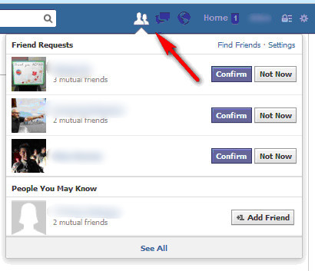
Motivation
Machine Learning is EVERYWHERE!!
[ Weller 2017 ]
Notes:
PICTURES!!

Slide 16




Motivation: Why Model Understanding?
Input
This model is relying on incorrect features to make this prediction!! Let me fix the model
Model understanding facilitates debugging.
Model Understanding
Predictive
Model
Prediction = Siberian Husky

Slide 17


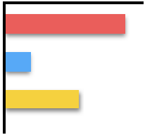

Motivation: Why Model Understanding?
This prediction is biased. Race and gender are being used to make the prediction!!
Defendant Details
Model understanding facilitates bias detection.
Model Understanding
Race
Crimes
Gender
Predictive
Model
Prediction = Risky to Release
[ Larson et. al. 2016 ]

Slide 18

Motivation: Why Model Understanding?
Model Understanding
Increase salary by 50K + pay credit card bills on time for next 3 months to get a loan
I have some means for recourse. Let me go and work on my promotion and pay my bills on time.
Loan Applicant Details
Model understanding helps provide recourse to individuals who are adversely affected by model predictions.
Predictive
Model
Prediction = Denied Loan
Loan Applicant

Slide 19

Motivation: Why Model Understanding?
Model Understanding
Patient Data
This model is using irrelevant features when predicting on female subpopulation. I should not trust its predictions for that group.
If gender = female,
if ID_num > 200, then sick
If gender = male,
if cold = true and cough = true, then sick
25, Female, Cold
32, Male, No
31, Male, Cough
Model understanding helps assess if and when to trust model predictions when making decisions.
Predictions
Healthy
Sick
Sick
.
.
Healthy
Healthy
Sick
Predictive
Model

Slide 20

Motivation: Why Model Understanding?
Model Understanding
Patient Data
If gender = female,
if ID_num > 200, then sick
If gender = male,
if cold = true and cough = true, then sick
This model is using irrelevant features when predicting on female subpopulation. This cannot be approved!
25, Female, Cold
32, Male, No
31, Male, Cough
.
Predictions
Healthy
Sick
Sick
.
.
Healthy
Healthy
Sick
Predictive
Model

Slide 21
Motivation: Why Model Understanding?
Utility
Stakeholders
Debugging
Bias Detection
Recourse
If and when to trust model predictions
Vet models to assess suitability for deployment
End users (e.g., loan applicants)
Decision makers (e.g., doctors, judges)
Regulatory agencies (e.g., FDA, European commission)
Researchers and engineers

Slide 22
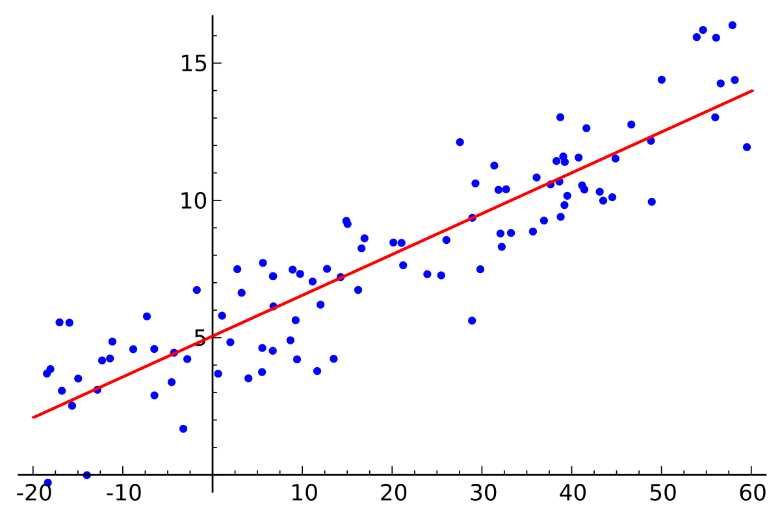
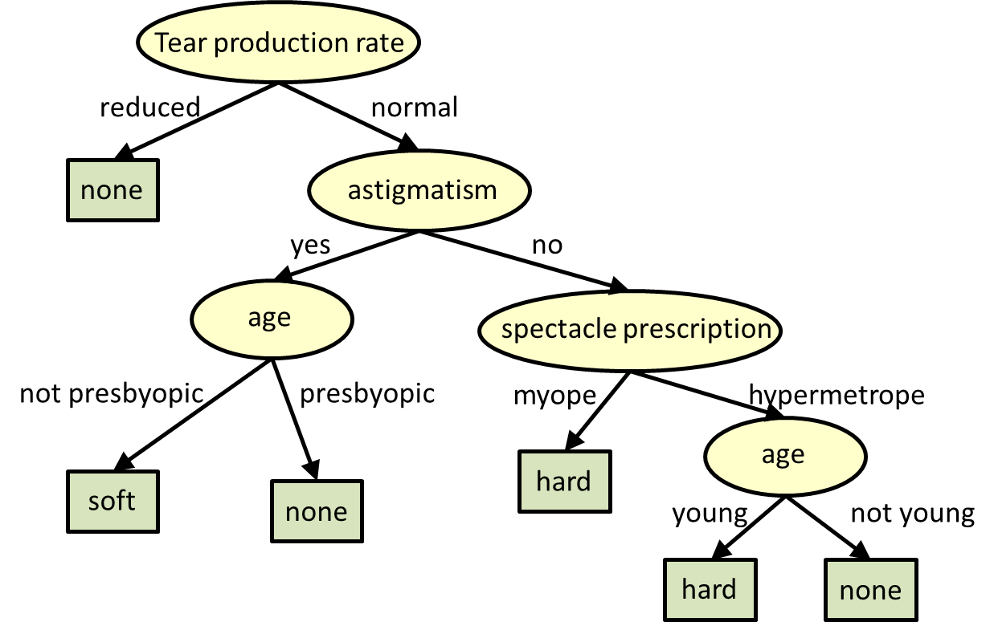
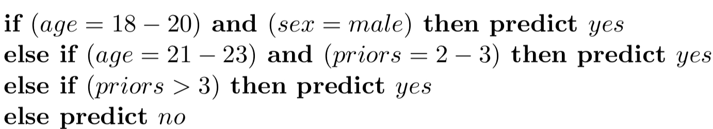
Achieving Model Understanding
Take 1: Build inherently interpretable predictive models
[ Letham and Rudin 2015; Lakkaraju et. al. 2016 ]

Slide 23


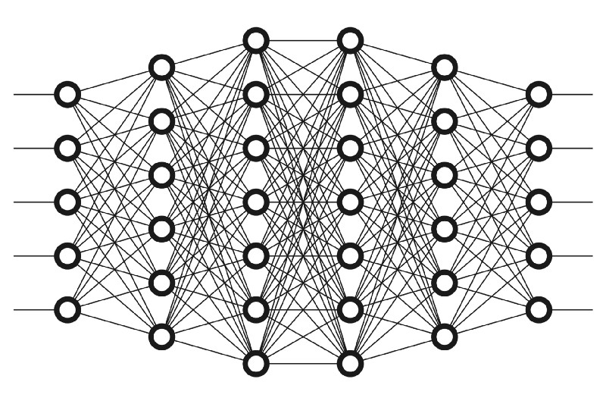
Achieving Model Understanding
Take 2: Explain pre-built models in a post-hoc manner
Explainer
[ Ribeiro et. al. 2016, 2018; Lakkaraju et. al. 2019]

Slide 24
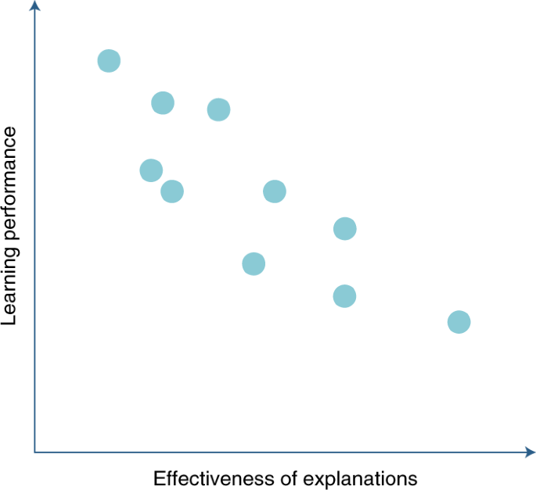
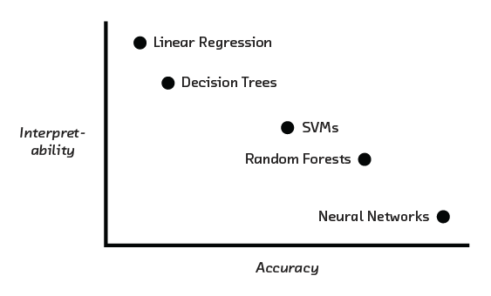
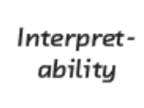

Inherently Interpretable Models vs.
Post hoc Explanations
Example
In certain settings, accuracy-interpretability trade offs may exist.
[ Cireşan et. al. 2012, Caruana et. al. 2006, Frosst et. al. 2017, Stewart 2020]
Notes:
CITATION!!!!!!

Slide 25
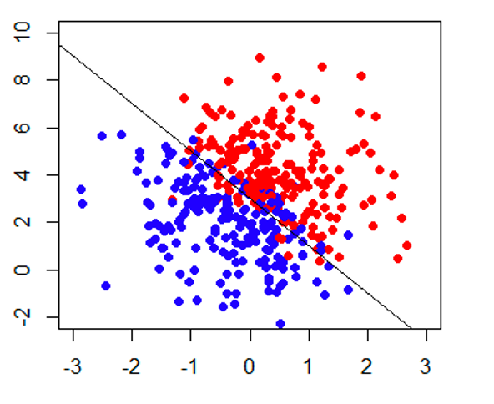
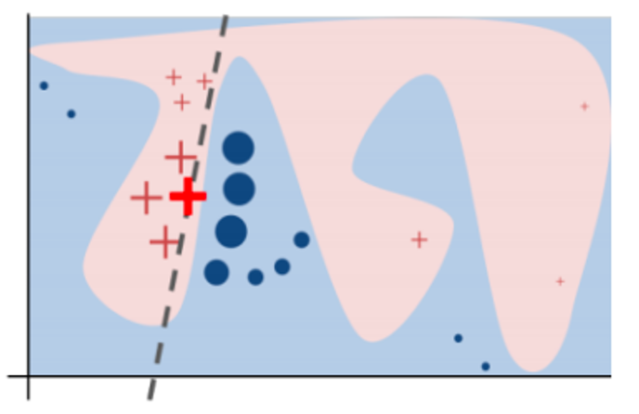
Inherently Interpretable Models vs.
Post hoc Explanations
complex models might achieve higher accuracy
can build interpretable +
accurate models

Slide 26

Inherently Interpretable Models vs.
Post hoc Explanations
Sometimes, you don’t have enough data to build your model from scratch.
And, all you have is a (proprietary) black box!
[ Ribeiro et. al. 2016 ]

Slide 27
Inherently Interpretable Models vs.
Post hoc Explanations
If you can build an interpretable model which is also adequately accurate for your setting, DO IT!
Otherwise, post hoc explanations come to the rescue!

Slide 28
Let’s get into some details!

Slide 29
Next Up!
Define and evaluate interpretability
somewhat! ☺
Taxonomy of interpretability evaluation
Taxonomy of interpretability based on applications/tasks
Taxonomy of interpretability based on methods
[Doshi-Velez & Kim, 2017]

Slide 30
Motivation for Interpretability
ML systems are being deployed in complex high-stakes settings
Accuracy alone is no longer enough
Auxiliary criteria are important:
Safety
Nondiscrimination
Right to explanation

Slide 31
Motivation for Interpretability
Auxiliary criteria are often hard to quantify (completely)
E.g.: Impossible to enumerate all scenarios violating safety of an autonomous car
Fallback option: interpretability
If the system can explain its reasoning, we can verify if that reasoning is sound w.r.t. auxiliary criteria

Slide 32
Prior Work: Defining and Measuring Interpretability
Little consensus on what interpretability is and how to evaluate it
Interpretability evaluation typically falls into:
Evaluate in the context of an application
Evaluate via a quantifiable proxy

Slide 33
Prior Work: Defining and Measuring Interpretability
Evaluate in the context of an application
If a system is useful in a practical application or a simplified version, it must be interpretable
Evaluate via a quantifiable proxy
Claim some model class is interpretable and present algorithms to optimize within that class
E.g. rule lists
You will know it when you see it!

Slide 34
Lack of Rigor?
Yes and No
Previous notions are reasonable
However,
Are all models in all “interpretable” model classes equally interpretable?
Model sparsity allows for comparison
How to compare a linear model with a decision tree?
Do all applications have same interpretability needs?
Important to formalize these notions!!!

Slide 35
What is Interpretability?
Defn: Ability to explain or to present in understandable terms to a human
No clear answers in psychology to:
What constitutes an explanation?
What makes some explanations better than the others?
When are explanations sought?

Slide 36
When and Why Interpretability?
Not all ML systems require interpretability
E.g., ad servers, postal code sorting
No human intervention
No explanation needed because:
No consequences for unacceptable results
Problem is well studied and validated well in real-world applications → trust system’s decision
When do we need explanation then?

Slide 37
When and Why Interpretability?
Incompleteness in problem formalization
Hinders optimization and evaluation
Incompleteness ≠ Uncertainty
Uncertainty can be quantified
E.g., trying to learn from a small dataset (uncertainty)

Slide 38
Incompleteness: Illustrative Examples
Scientific Knowledge
E.g., understanding the characteristics of a large dataset
Goal is abstract
Safety
End to end system is never completely testable
Not possible to check all possible inputs
Ethics
Guard against certain kinds of discrimination which are too abstract to be encoded
No idea about the nature of discrimination beforehand

Slide 39
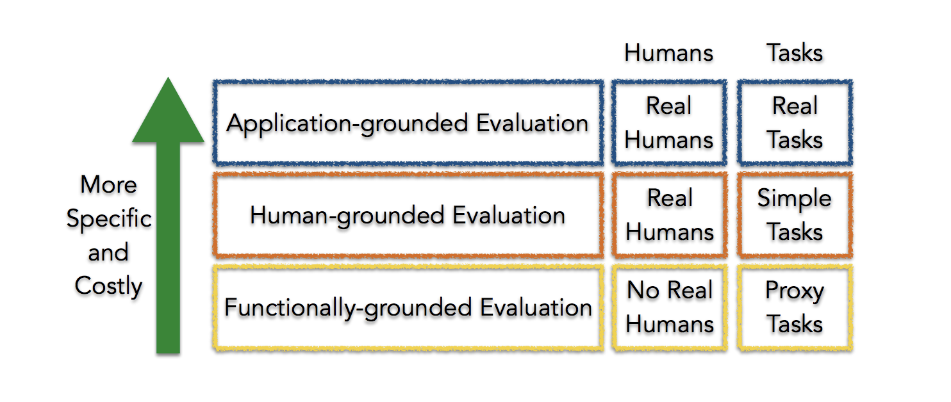
Taxonomy of Interpretability Evaluation
Claim of the research should match the type of the evaluation!

Slide 40
Application-grounded evaluation
Real humans (domain experts), real tasks
Domain experts experiment with exact application task
Domain experts experiment with a simpler or partial task
Shorten experiment time
Increases number of potential subjects
Typical in HCI and visualization communities

Slide 41
Human-grounded evaluation
Real humans, simplified tasks
Can be completed with lay humans
Larger pool, less expensive
Potential experiments
Pairwise comparisons
Simulate the model output
What changes should be made to input to change the output?

Slide 42
Functionally-grounded evaluation
No humans, just proxies
Appropriate for a class of models already validated
E.g., decision trees
A method is not yet mature
Human subject experiments are unethical
What proxies to use?
Potential experiments
Complexity (of a decision tree) compared to other other models of the same (similar) class
How many levels? How many rules?

Slide 43
Open Problems: Design Issues
What proxies are best for what real world applications?
What factors to consider when designing simpler tasks in place of real world tasks?

Slide 44
Taxonomy based on applications/tasks
Global vs. Local
High level patterns vs. specific decisions
Degree of Incompleteness
What part of the problem is incomplete? How incomplete is it?
Incomplete inputs or constraints or costs?
Time Constraints
How much time can the user spend to understand explanation?

Slide 45
Taxonomy based on applications/tasks
Nature of User Expertise
How experienced is end user?
Experience affects how users process information
E.g., domain experts can handle detailed, complex explanations compared to opaque, smaller ones
Note: These taxonomies are constructed based on intuition and are not data or evidence driven. They must be treated as hypotheses.

Slide 46
Taxonomy based on methods
Basic units of explanation:
Raw features? E.g., pixel values
Semantically meaningful? E.g., objects in an image
Prototypes?
Number of basic units of explanation:
How many does the explanation contain?
How do various types of basic units interact?
E.g., prototype vs. feature

Slide 47
Taxonomy based on methods
Level of compositionality:
Are the basic units organized in a structured way?
How do the basic units compose to form higher order units?
Interactions between basic units:
Combined in linear or non-linear ways?
Are some combinations easier to understand?
Uncertainty:
What kind of uncertainty is captured by the methods?
How easy is it for humans to process uncertainty?

Slide 48
Questions??

Slide 49
Relevant Conferences to Explore
ICML
NeurIPS
ICLR
UAI
AISTATS
KDD
AAAI
FAccT
AIES
CHI
CSCW
HCOMP

Slide 50
Breakout Groups
Say hi to your neighbors! Introduce yourselves!
What topics are you most excited about learning as part of this course?
Are you convinced that model interpretability/explainability is important?
Do you think we can really interpret/explain models (correctly)?
What is your take on inherently interpretable models vs. post hoc explanations? Would you favor one over the other? Why?

Slide 51


